Slide 1
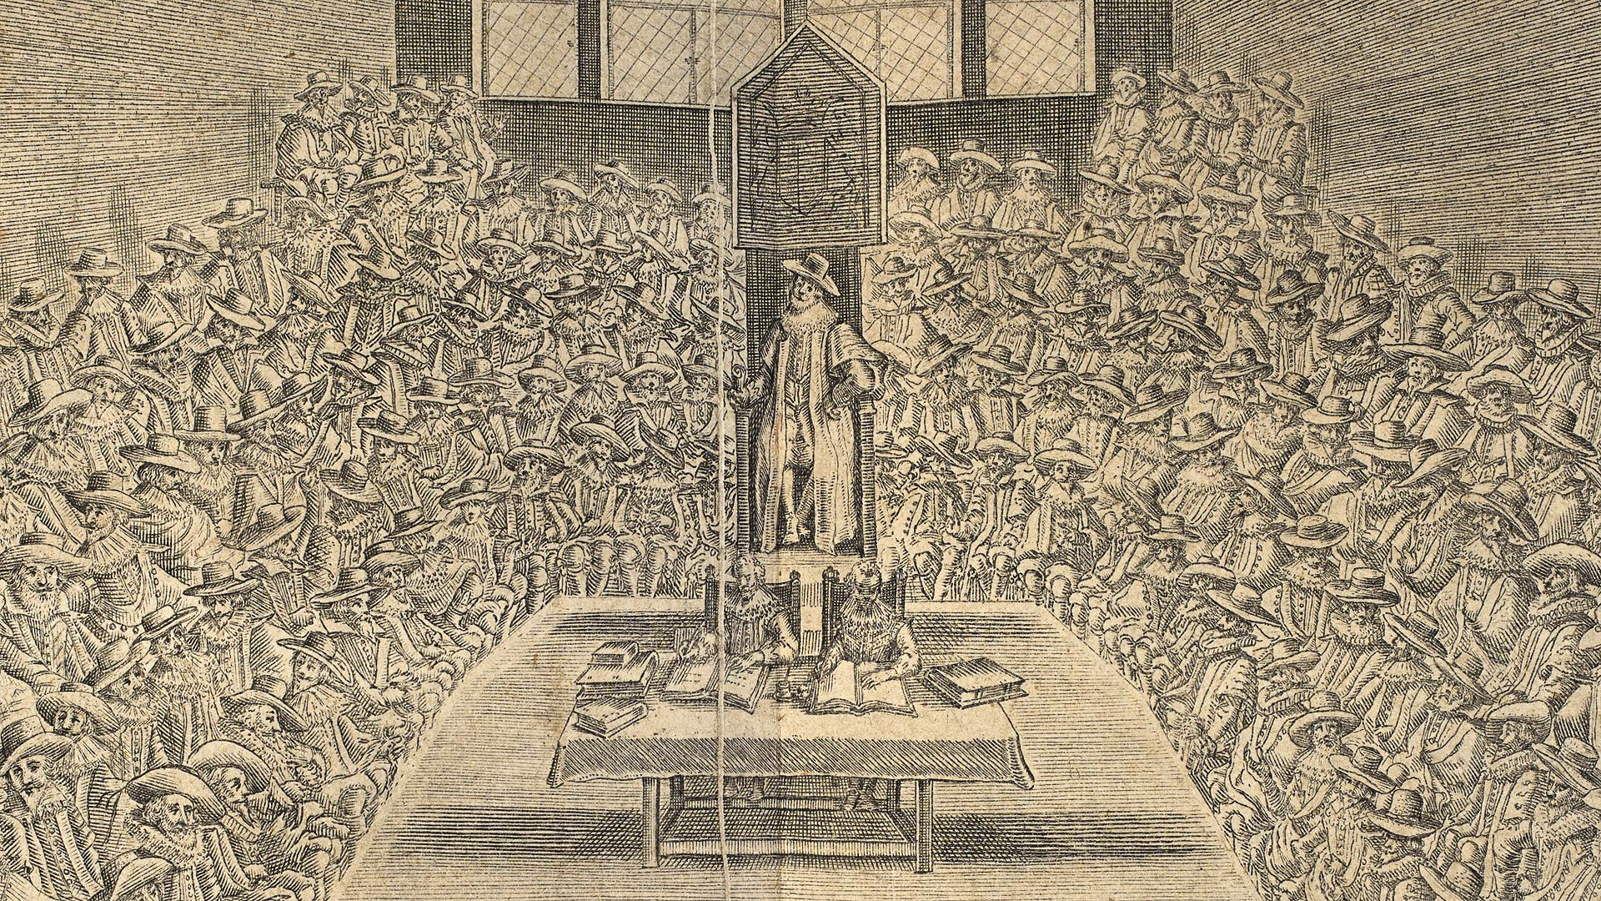
PUBLIC LAW: Lecture 2
BASIC CONSTITUTIONAL PRINCIPLES

Slide 2

Lecture 2
Sources of the UK Constitution
Changing nature of the Crown
Constitutional Principles
Separation of Powers in the UK
Constitutional Reform Act 2005

Slide 3
Sources of the UK Constitution
The UK has an uncodified constitution.
This does not mean none of it is written down – ‘unwritten’ is not very helpful. The UK’s has a multitude of different sources:
statute (Acts of Parliament)
common law
conventions
official documents, e.g. The Ministerial Code and Cabinet Manual – particularly helpful for setting out conventions
academic writing, e.g. Dicey
normative ideas: what rights should we have?

Slide 4
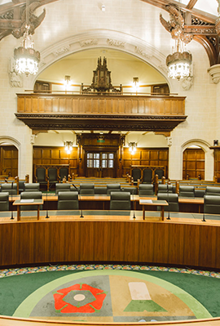
Miller No 1
“Unlike most countries, the United Kingdom does not have a constitution in the sense of a single coherent code of fundamental law which prevails over all other sources of law. Our constitutional arrangements have developed over time in a pragmatic as much as in a principled way, through a combination of statutes, events, conventions, academic writings and judicial decisions.”
R (Miller) v Secretary of State for Exiting the European Union [2017] UKSC 5 [40]

Slide 5
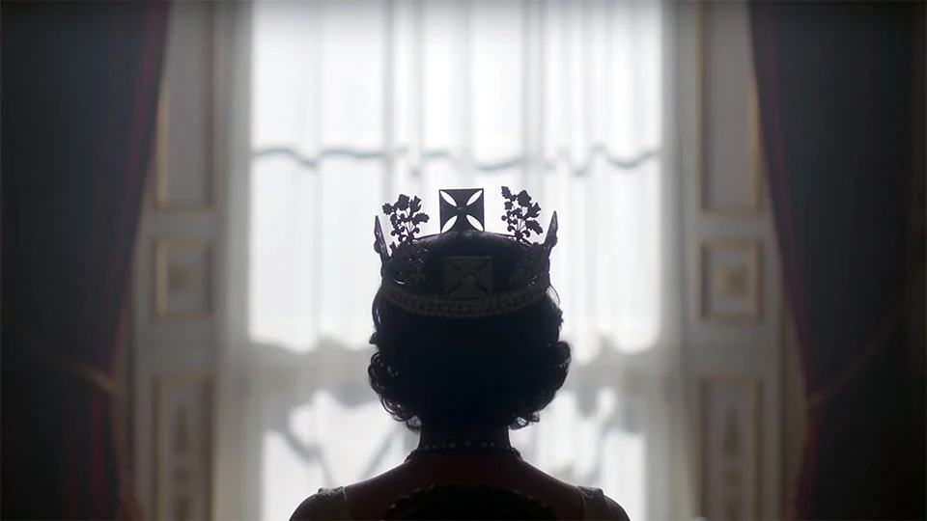
The Crown (not the one on Netflix)

Slide 6
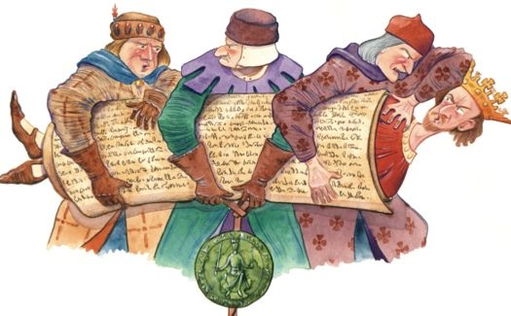
1215 Magna Carta
The first notable source of the UK Constitution
Formal limits to the legal powers of the Monarch

Slide 7
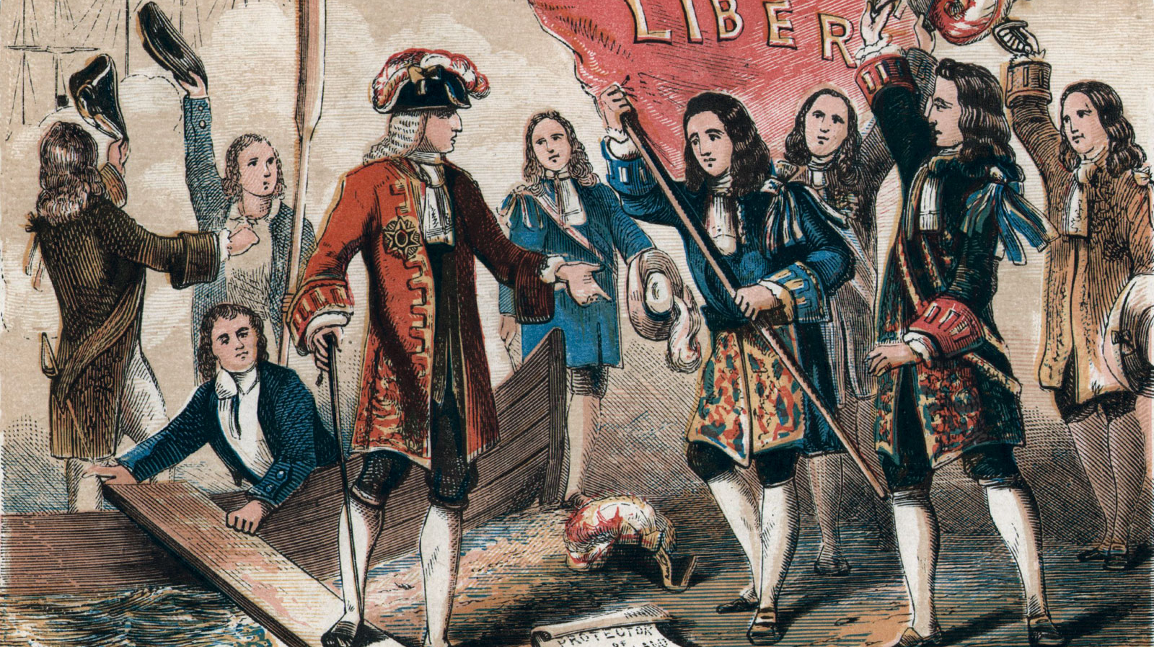
1688 Glorious Revolution and 1689 Bill of Rights
Parliament supports William of Orange’s claim to the throne in exchange for certain Parliamentary freedoms:
Monarch cannot executing or suspend laws without Parliamentary approval.
Parliament is to meet frequently
Parliamentary privilege: freedom of speech in Parliament.
Beginnings of ‘Parliamentary sovereignty’

Slide 8
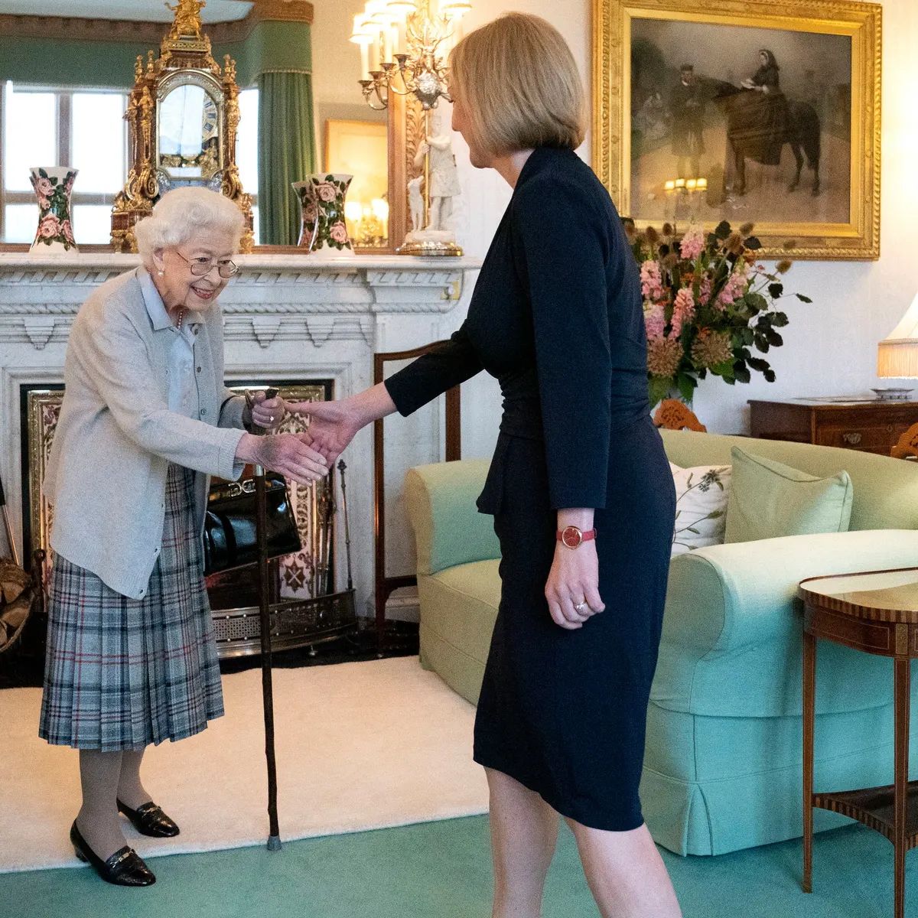
What does the Crown mean within the modern system?
Diminishing role and power
Minor role in the modern constitution
Grants Royal Assent to legislation
Reserved powers to ’ including to choose PM and dissolve Parliament
‘consult, encourage, warn’
broadly ceremonial role
Other personal powers: cannot be individually prosecuted or sued (Crown Proceedings Act 1947), appoints to Order of Merit.

Slide 9
Ministers on the behalf of the Crown
‘The Crown’s administrative powers are now exercised by the executive, i.e. by ministers who are answerable to the UK Parliament. However, consistently with the principles established in the 17th century, the exercise of those powers must be compatible with legislation and the common law. Otherwise, ministers would be changing (or infringing) the law, which, as just explained, they cannot do’: Miller, [45].

Slide 10
Three Constitutional Principles
Parliamentary Sovereignty (Lecture 3)
‘The first is the principle of Parliamentary sovereignty: that laws enacted by the Crown in Parliament are the supreme form of law in our legal system, with which everyone, including the Government, must comply.’ - Cherry and others (Respondents) v Advocate General for Scotland (Appellant) (Scotland) [2019] UKSC 41 [41]
Rule of Law (Lecture 4)
‘At the heart of the concept of the rule of law is the idea that society is governed by law.’ UNISON [68]
Separation of Powers
Today’s focus

Slide 11
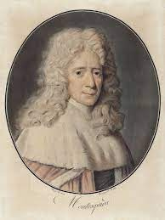
The Separation of Powers
Montesquieu L’Esprit de Lois 1758
‘When legislative power is united with executive power in a single person or in a single body of the magistracy, there is no liberty, because one can fear that the same monarch or senate that makes tyrannical laws will execute them tyrannically.
Nor is there liberty if the power of judging is not separate from legislative power and from executive power. If it were joined to legislative power, the power over the life and liberty of the citizen would be arbitrary, for the judge would be the legislator. If it were joined to executive power, the judge could have the force of an oppressor.
All would be lost if the same man or the same body of principal men, either of nobles, or of the people, exercised these three powers: that of making the laws, that of executing public resolutions, and that of judging the crimes or the disputes of individuals.’
Rationale: Preserve liberty and prevent the abuse of power
Checks and balances

Slide 12

The Value of the Separation of Powers
What is the value in this?
Hypothetical scenario
To what extent does the absence of a separation of powers enable abuse of power in this scenario?
What would have happened if there was a separation of powers to some extent?
‘Power tends to corrupt and absolute power corrupts absolutely.’ (Lord Acton)

Slide 13
Three Branches of State
Legislative:
the Crown, the House of Commons and the House of Lords
Making legislation
Parliamentary sovereignty
Holding the government to account
Executive:
the Crown and the Government, including the Prime Minister and Cabinet ministers
Sits in Parliament
Policy and administration
Accountable to Parliament
Judiciary:
Appointed judges
Rule of law
Adjudication
Statutory interpretation

Slide 14

Degrees of Separation
Absolute power → one body/person exercising all three functions → no separation
Absolute (pure) separation → 3 separate bodies exercising 3 separate function + no overlap in function or personnel
Fusion → some overlap between functions and personnel but checks and balances → weak separation → mixed government.

Slide 15
Separation of powers in the UK
Checking and balancing
Functions
Legislature
Executive
Legislature
Judiciary
Executive
Judiciary

Slide 16
Executive and Legislature
Parliament is the legislature.
BUT the executive sits within Parliament - the government is the group of MPs led by whoever can command the confidence of the House of Commons – and therefore there is no firm separation between executive and legislature.
Barendt: ‘functions’ are separated instead.
importance of political controls on the executive.
‘secondary legislation’ and ‘Henry VIII’ powers.

Slide 17
Executive and Legislature
Executive and legislature in “close union, [a] nearly complete fusion of the executive and legislative powers … the efficient secret of the English constitution.” (Bagehot)
“a system that intentionally promotes efficiency over abstract concerns about tyranny.” (Krotoszynski)

Slide 18

Executive and Judiciary
Courts uphold the rule of law.
Prior to the Constitutional Reform Act 2005, the Lord Chancellor was a) head of the judiciary and b) a government minister and c) a judge.
This has now been changed:
Lord Chancellor is not a judge and is not head of the judiciary → Secretary of State for Justice
Lord Chief Justice is head of the judiciary and is not a politician
What has been lost? Judicial representation in government?

Slide 19
Executive and Judiciary
Should judges ‘defer’ to the executive?
“The citizen must be able to challenge the legitimacy of executive action before an independent judiciary. Because it is the executive that exercises the power of the State and because it is the executive, in one form or another, that is the most frequent litigator in the courts, it is from executive pressure or influence that judges require particularly to be protected.” (Lord Phillips)
Jackson v Her Majesty’s Attorney General [2005] UKHL 56
“It has been a source of concern to some constitutionalists [that] … the Commons, dominated by the executive, [functions] as the ultimately unconstrained power in the state.” [41]
“standing between the executive and citizens.” [102]

Slide 20
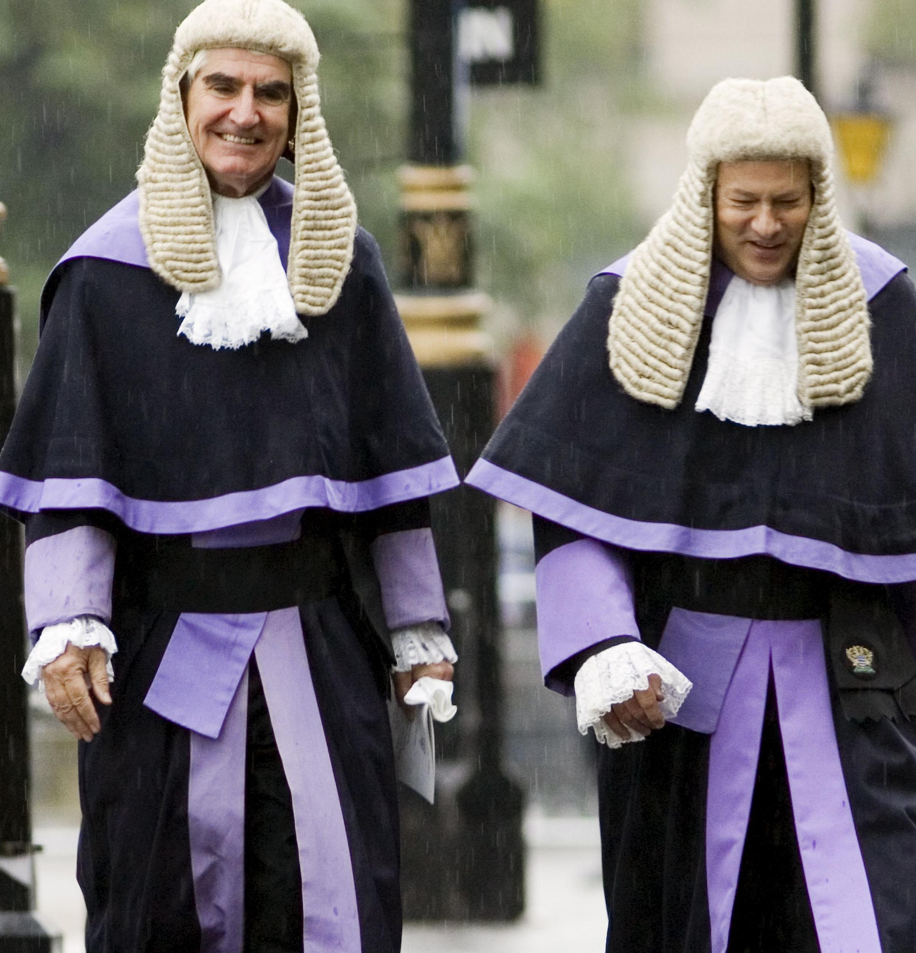
Legislature and Judiciary
Convention that members of executive should not criticise judges.
MPs prevented from raising matters which are ‘sub judice’ (before court or awaiting trial) in Parliament.
No court order would restrict/prohibit Parliamentary proceedings/debate → Article 9 Bill of Rights 1689 → “absolute privilege” (Lord Neuberger)
Judicial independence → Montesquieu “the independence of the judiciary has to be real and not apparent merely.” This is been supported by Barendt, Locke, Jennings and Dicey
Judges cannot invalidate primary legislation → judicial subordination to Parliament – Davis v Johnson [1979] AC 264

Slide 21
Legislature and Judiciary
Interpretive function – R v R [1991] 4 All ER 481
Dupont Steel Ltd and others v Sirs and others [1980] 1 All ER 529, HL
‘My Lords, at a time when more and more cases involving the application of legislation which gives effect to policies that are the subject of bitter public and parliamentary controversy, it cannot be too strongly emphasised that the British Constitution, though largely unwritten, is firmly based on the separation of powers: Parliament makes the laws, the judiciary interpret them. When Parliament legislates to remedy what the majority of its members at the time perceive to be a defect or a lacuna in the existing law (whether it be the written law enacted by existing statutes or the unwritten common law as it has been expounded by the judges in decided cases), the role of the judiciary is confined to ascertaining from the words that Parliament has approved as expressing its intention what that intention was, and to giving effect to it.’ (Lord Diplock) [541-2]

Slide 22
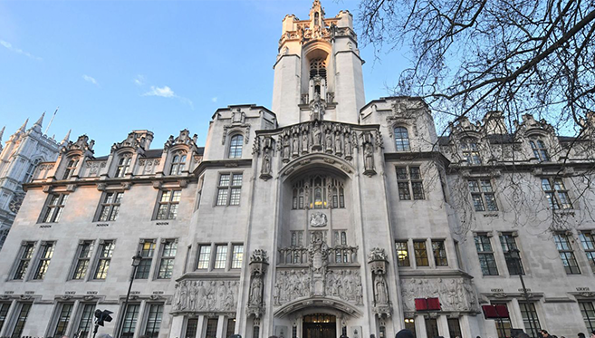
THE CONSTITUTIONAL REFORM ACT 2005
Before 2009
After 2009
Our highest court was the Appellate Committee of the House of Lords
our apex court was part of our legislature
judges were peers
R v Greater London Council, ex parte Blackburn [1976] 1 WLR 550, 555, Lord Denning: “In 1959 Parliament passed the Obscene Publications Act 1959. I remember it well. I attended the debates, and took part.”
Lord Bingham’s guidelines:
Judges have a right to contribute.
BUT will not do so where there is a ‘strong element of party political controversy’
AND remain aware that they may make themselves ineligible to sit in certain cases that relate to what they discussed.
The CRA 2005 created the Supreme Court
the Supreme Court is a separate institutional body
it is physically separate from Parliament
Supreme Court Justices are not automatically given a peerage

Slide 23
Summary
The UK’s constitution has multiple sources.
The Crown’s role has evolved over time.
There are three core constitutional principles → Parliamentary Sovereignty, Rule of Law and Separation of Powers
There are three branches of state → Legislation, Executive and Judiciary
There are different degrees of separation
The separation of powers is intended to:
prevent abuses of power
provide checks and balances
The UK’s separation of powers is partial.
The CRA 2005 made important changes https://www.legislation.gov.uk/ukpga/2005/4/pdfs/ukpgaen_20050004_en.pdf

Slide 24


